Slide 1
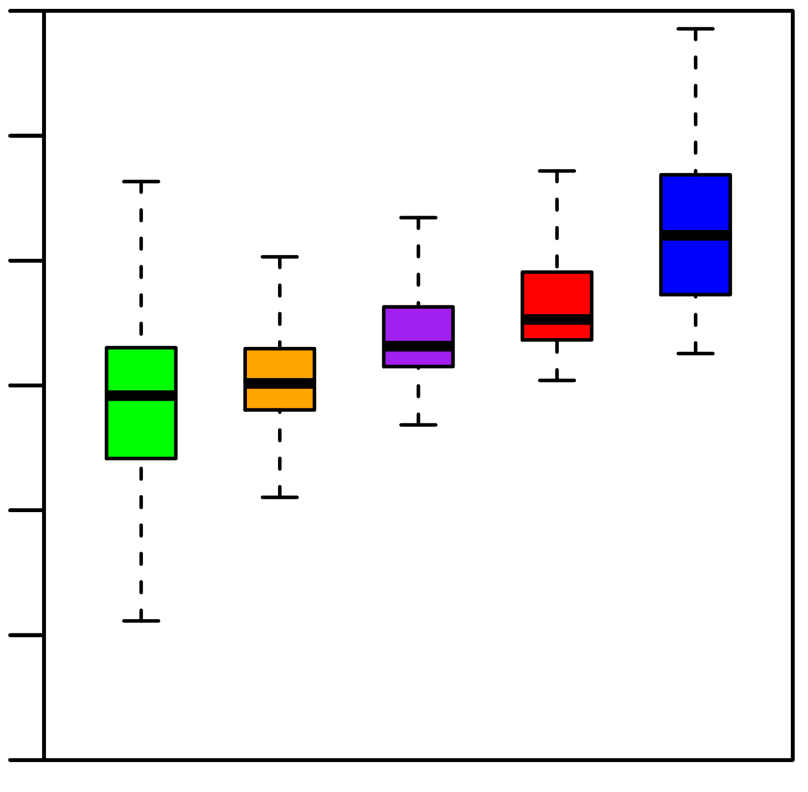
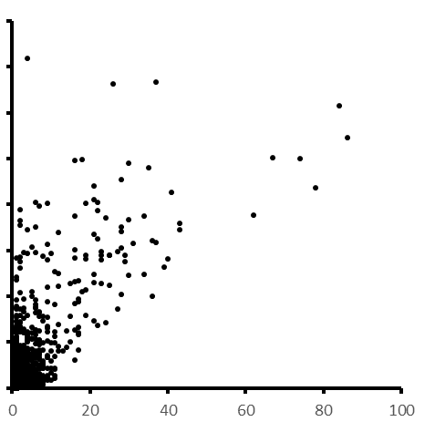
Supplementary Figure 1. Longer introns have more sisRNAs
A
10⁶
10⁴
Length (bps)
10²
0
0
0
1
2
3
>3
#sisRNAs
B
800K
R=0.72
600K
Length (bps)
400K
200K
0
#sisRNAs

Slide 2
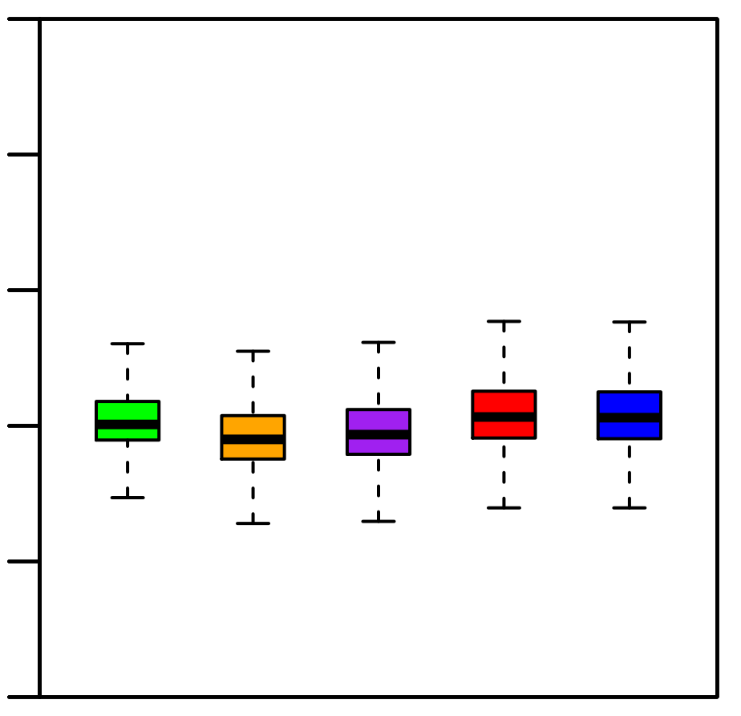
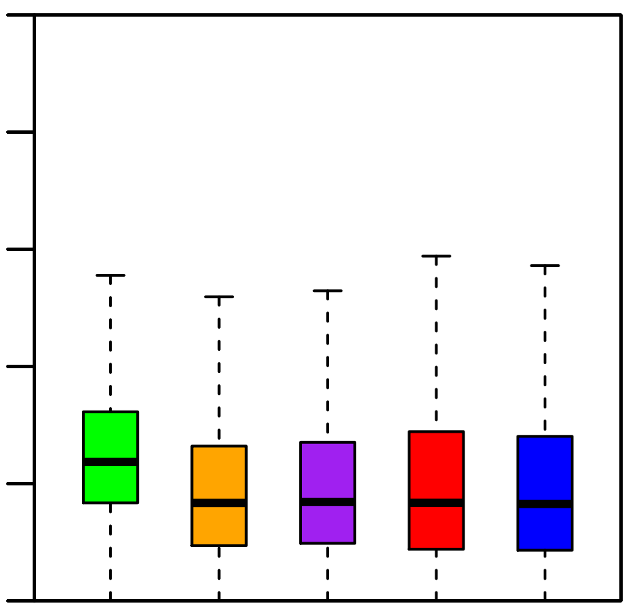
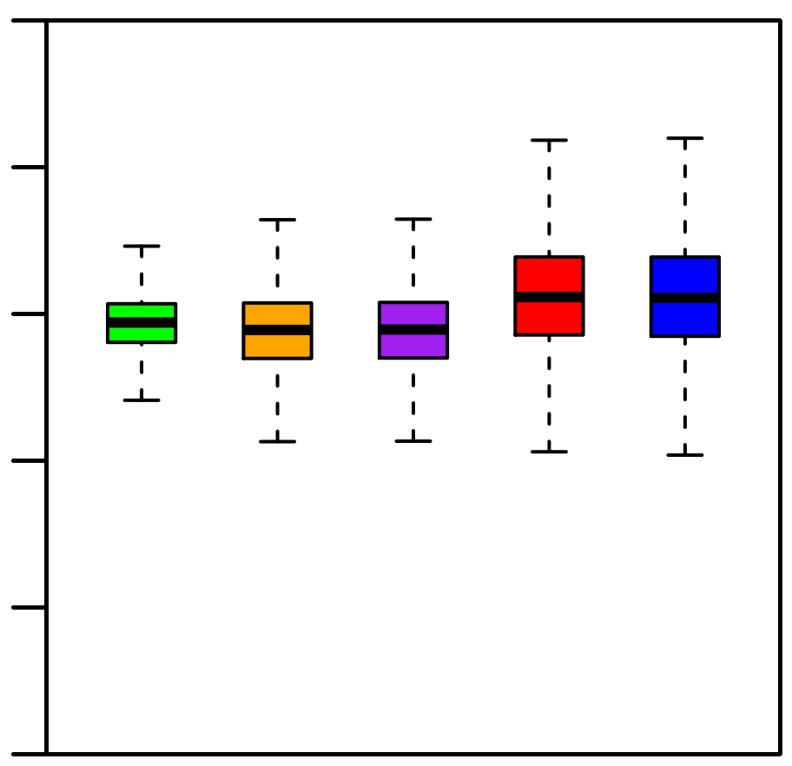
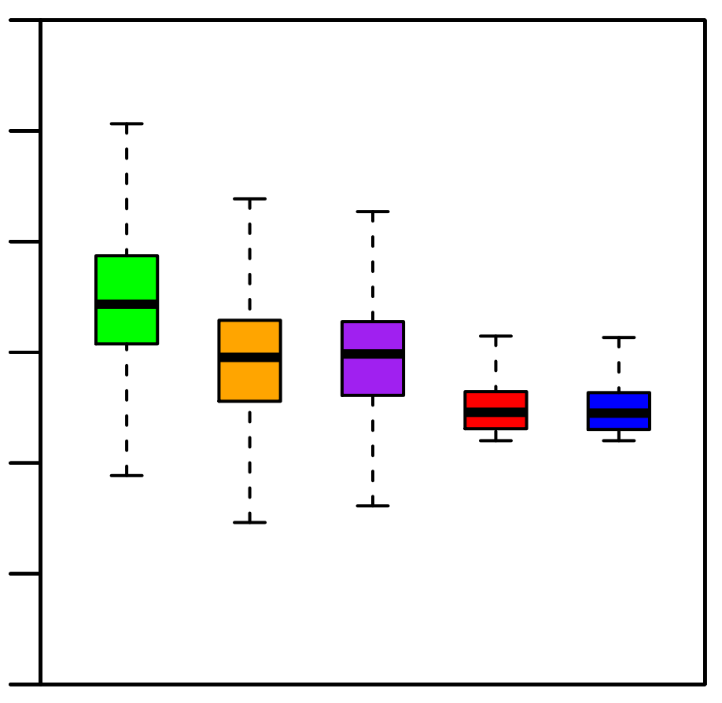
Supplementary Figure 2. sisRNAs are specific regions of the introns
A
C
100%
0.5
80%
0.4
60%
0.3
GC%
CA|TG density
40%
0.2
20%
0.1
0%
0
0.10
D
10⁶
B
0.08
10⁵
10⁴
0.06
length
CpG density
10³
0.04
10²
0.02
10
0
1
Intron S: 1st Intron
Intron M: Middle Introns
Intron E: Last Intron
sisRNAs identified by refSeq Genes
sisRNAs identified by Ensembl Genes

Slide 3
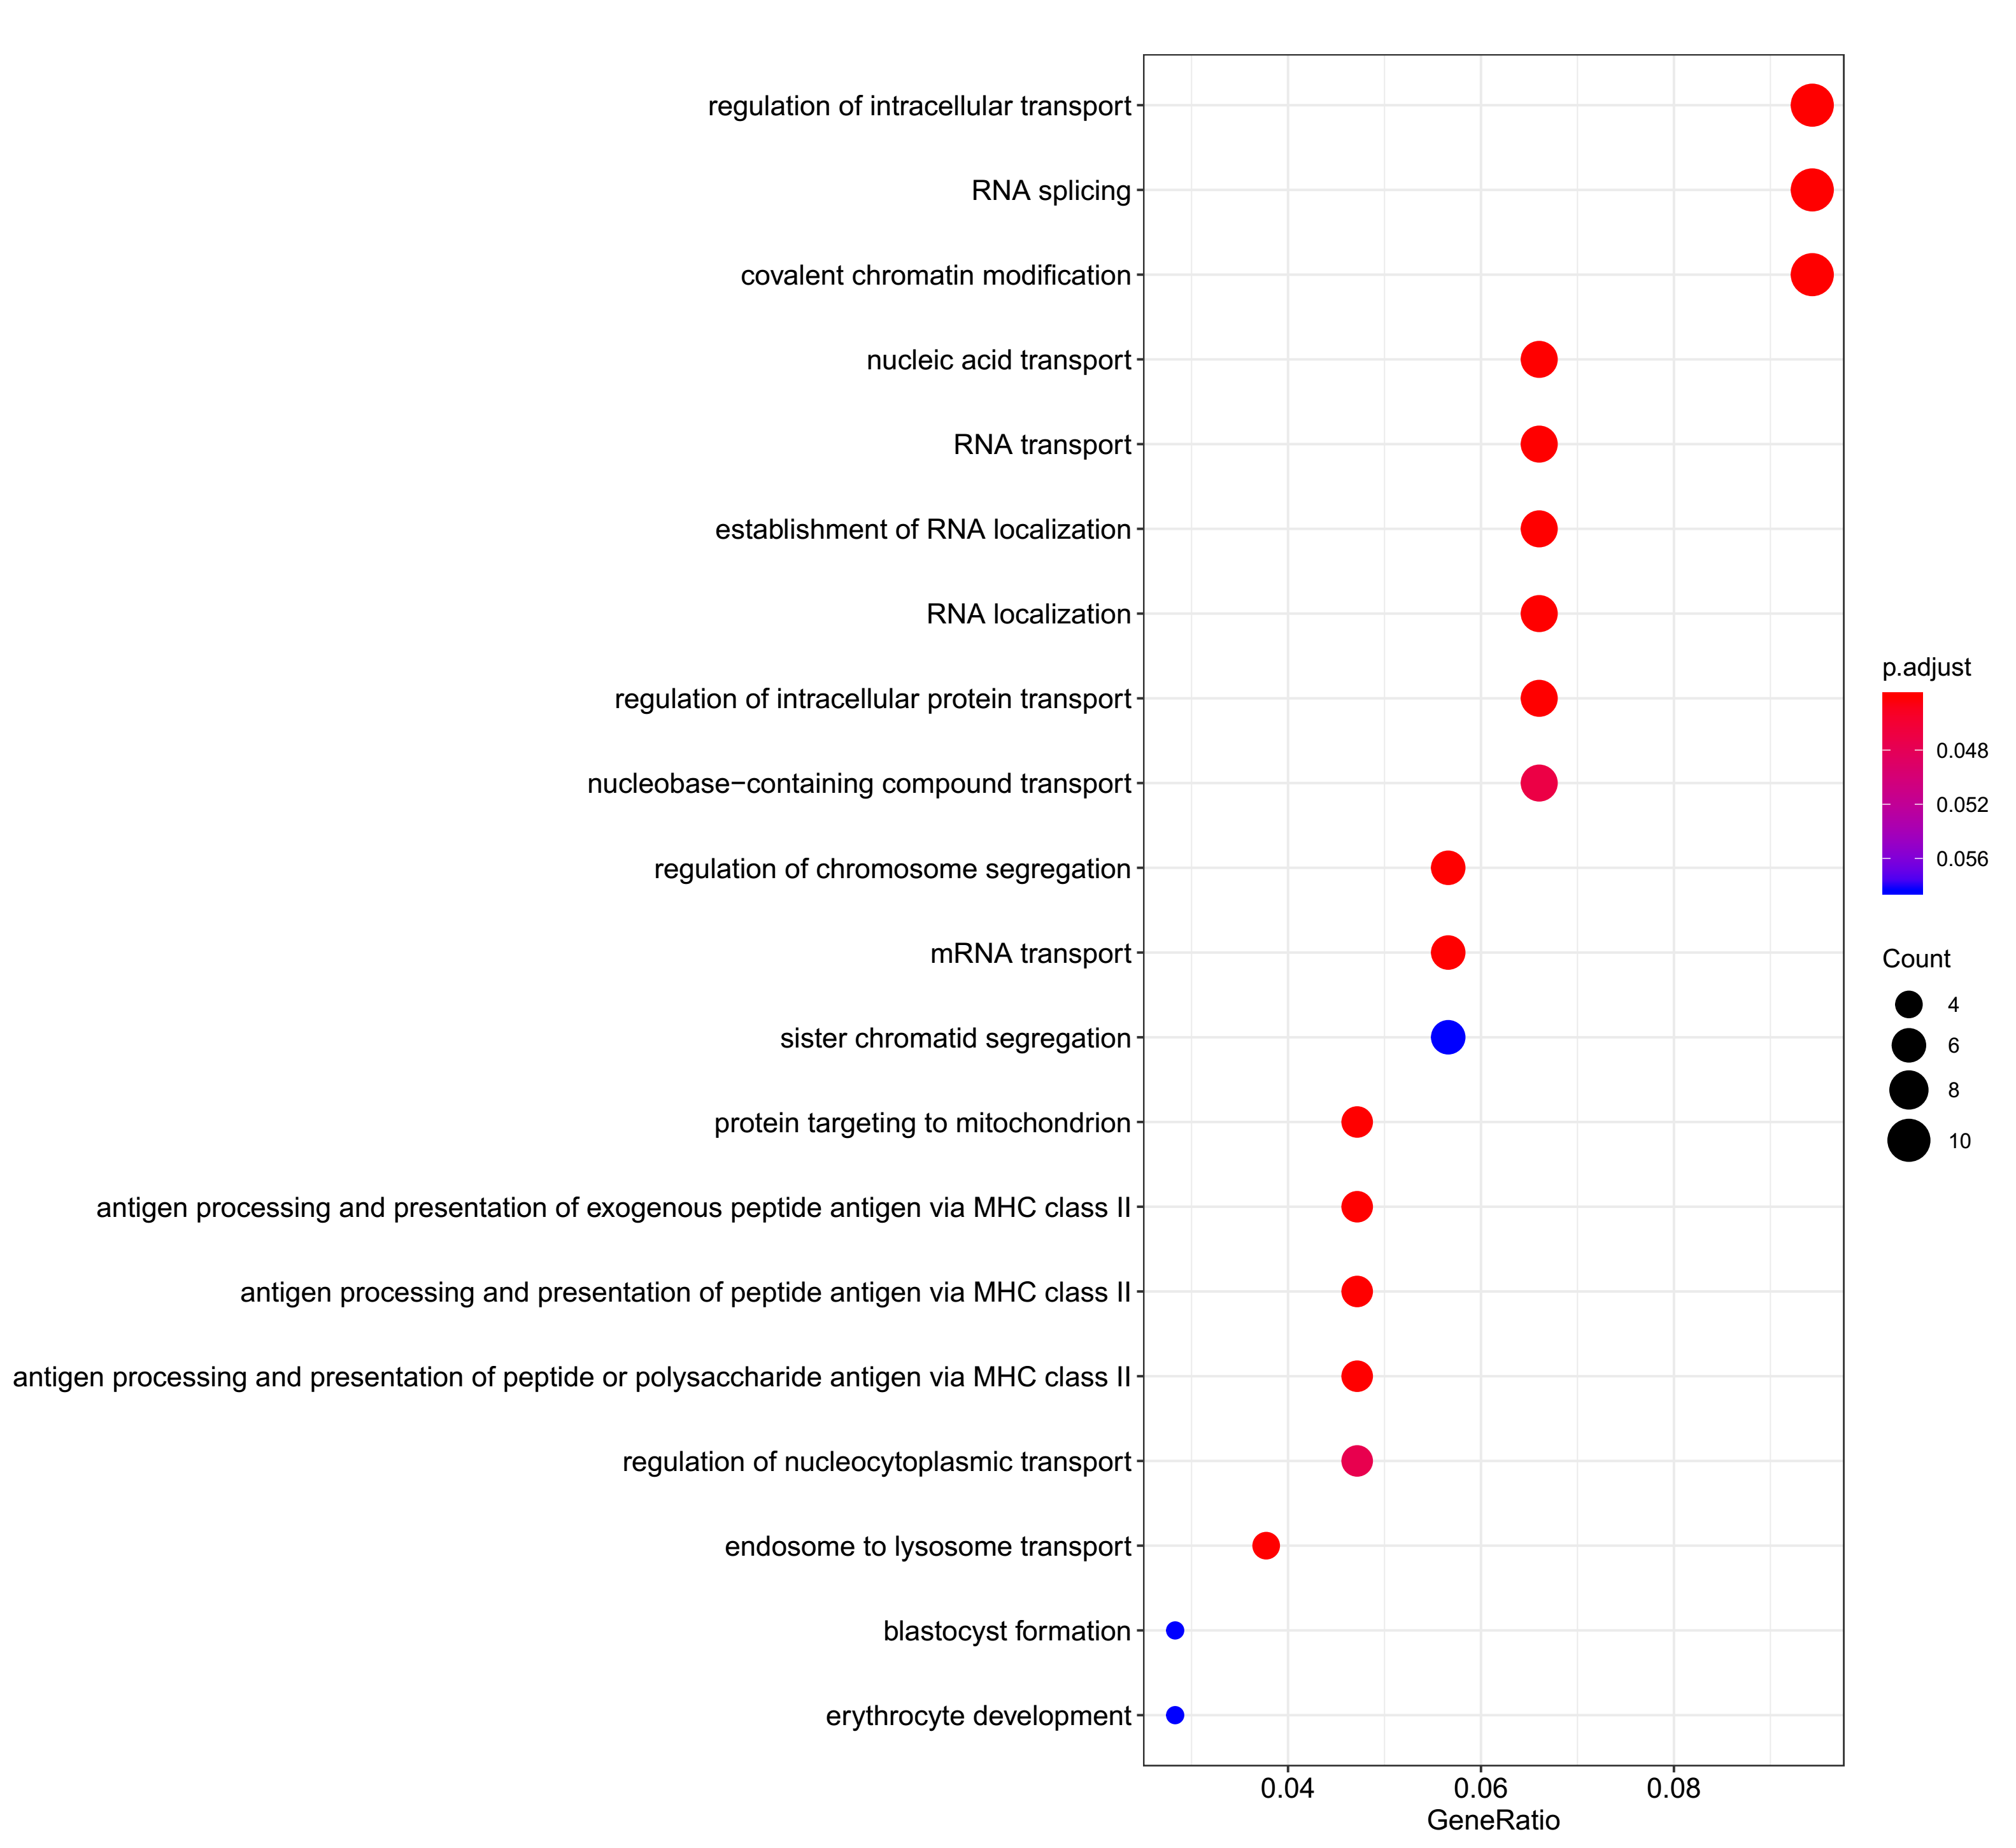
Supplementary Figure 3. GO analysis of the host genes of sisRNAs
3A Human RBC

Slide 4
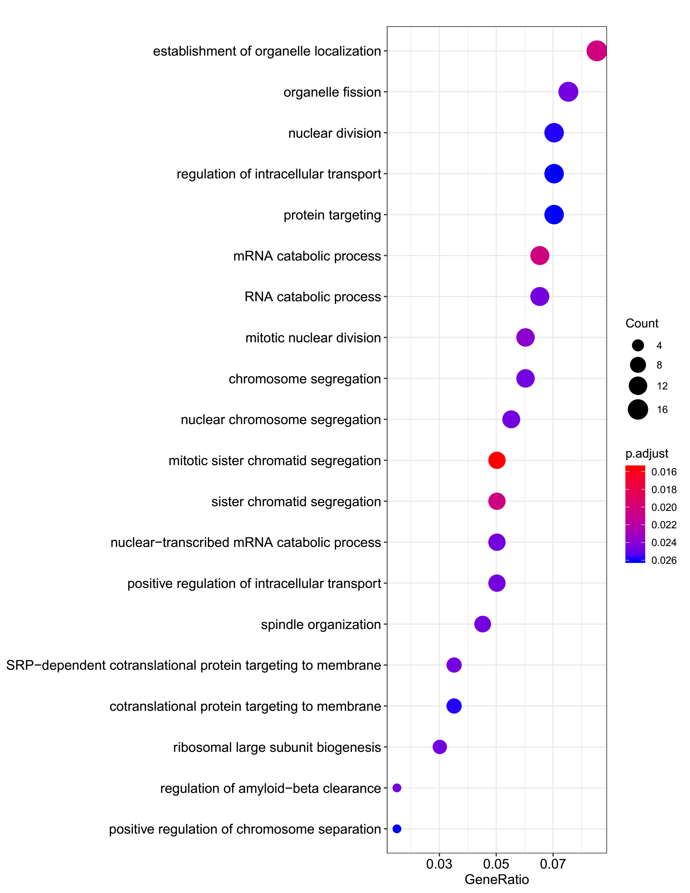
Supplementary Figure 3. GO analysis of the host genes of sisRNAs
3B Human Hela

Slide 5
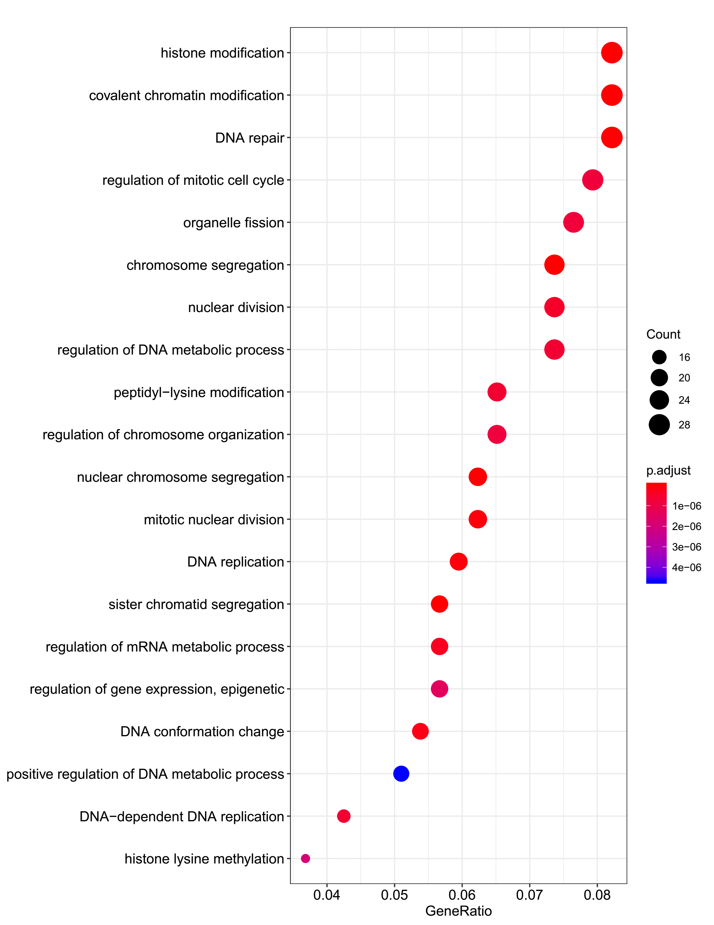
Supplementary Figure 3. GO analysis of the host genes of sisRNAs
3C Mouse RBC

Slide 6
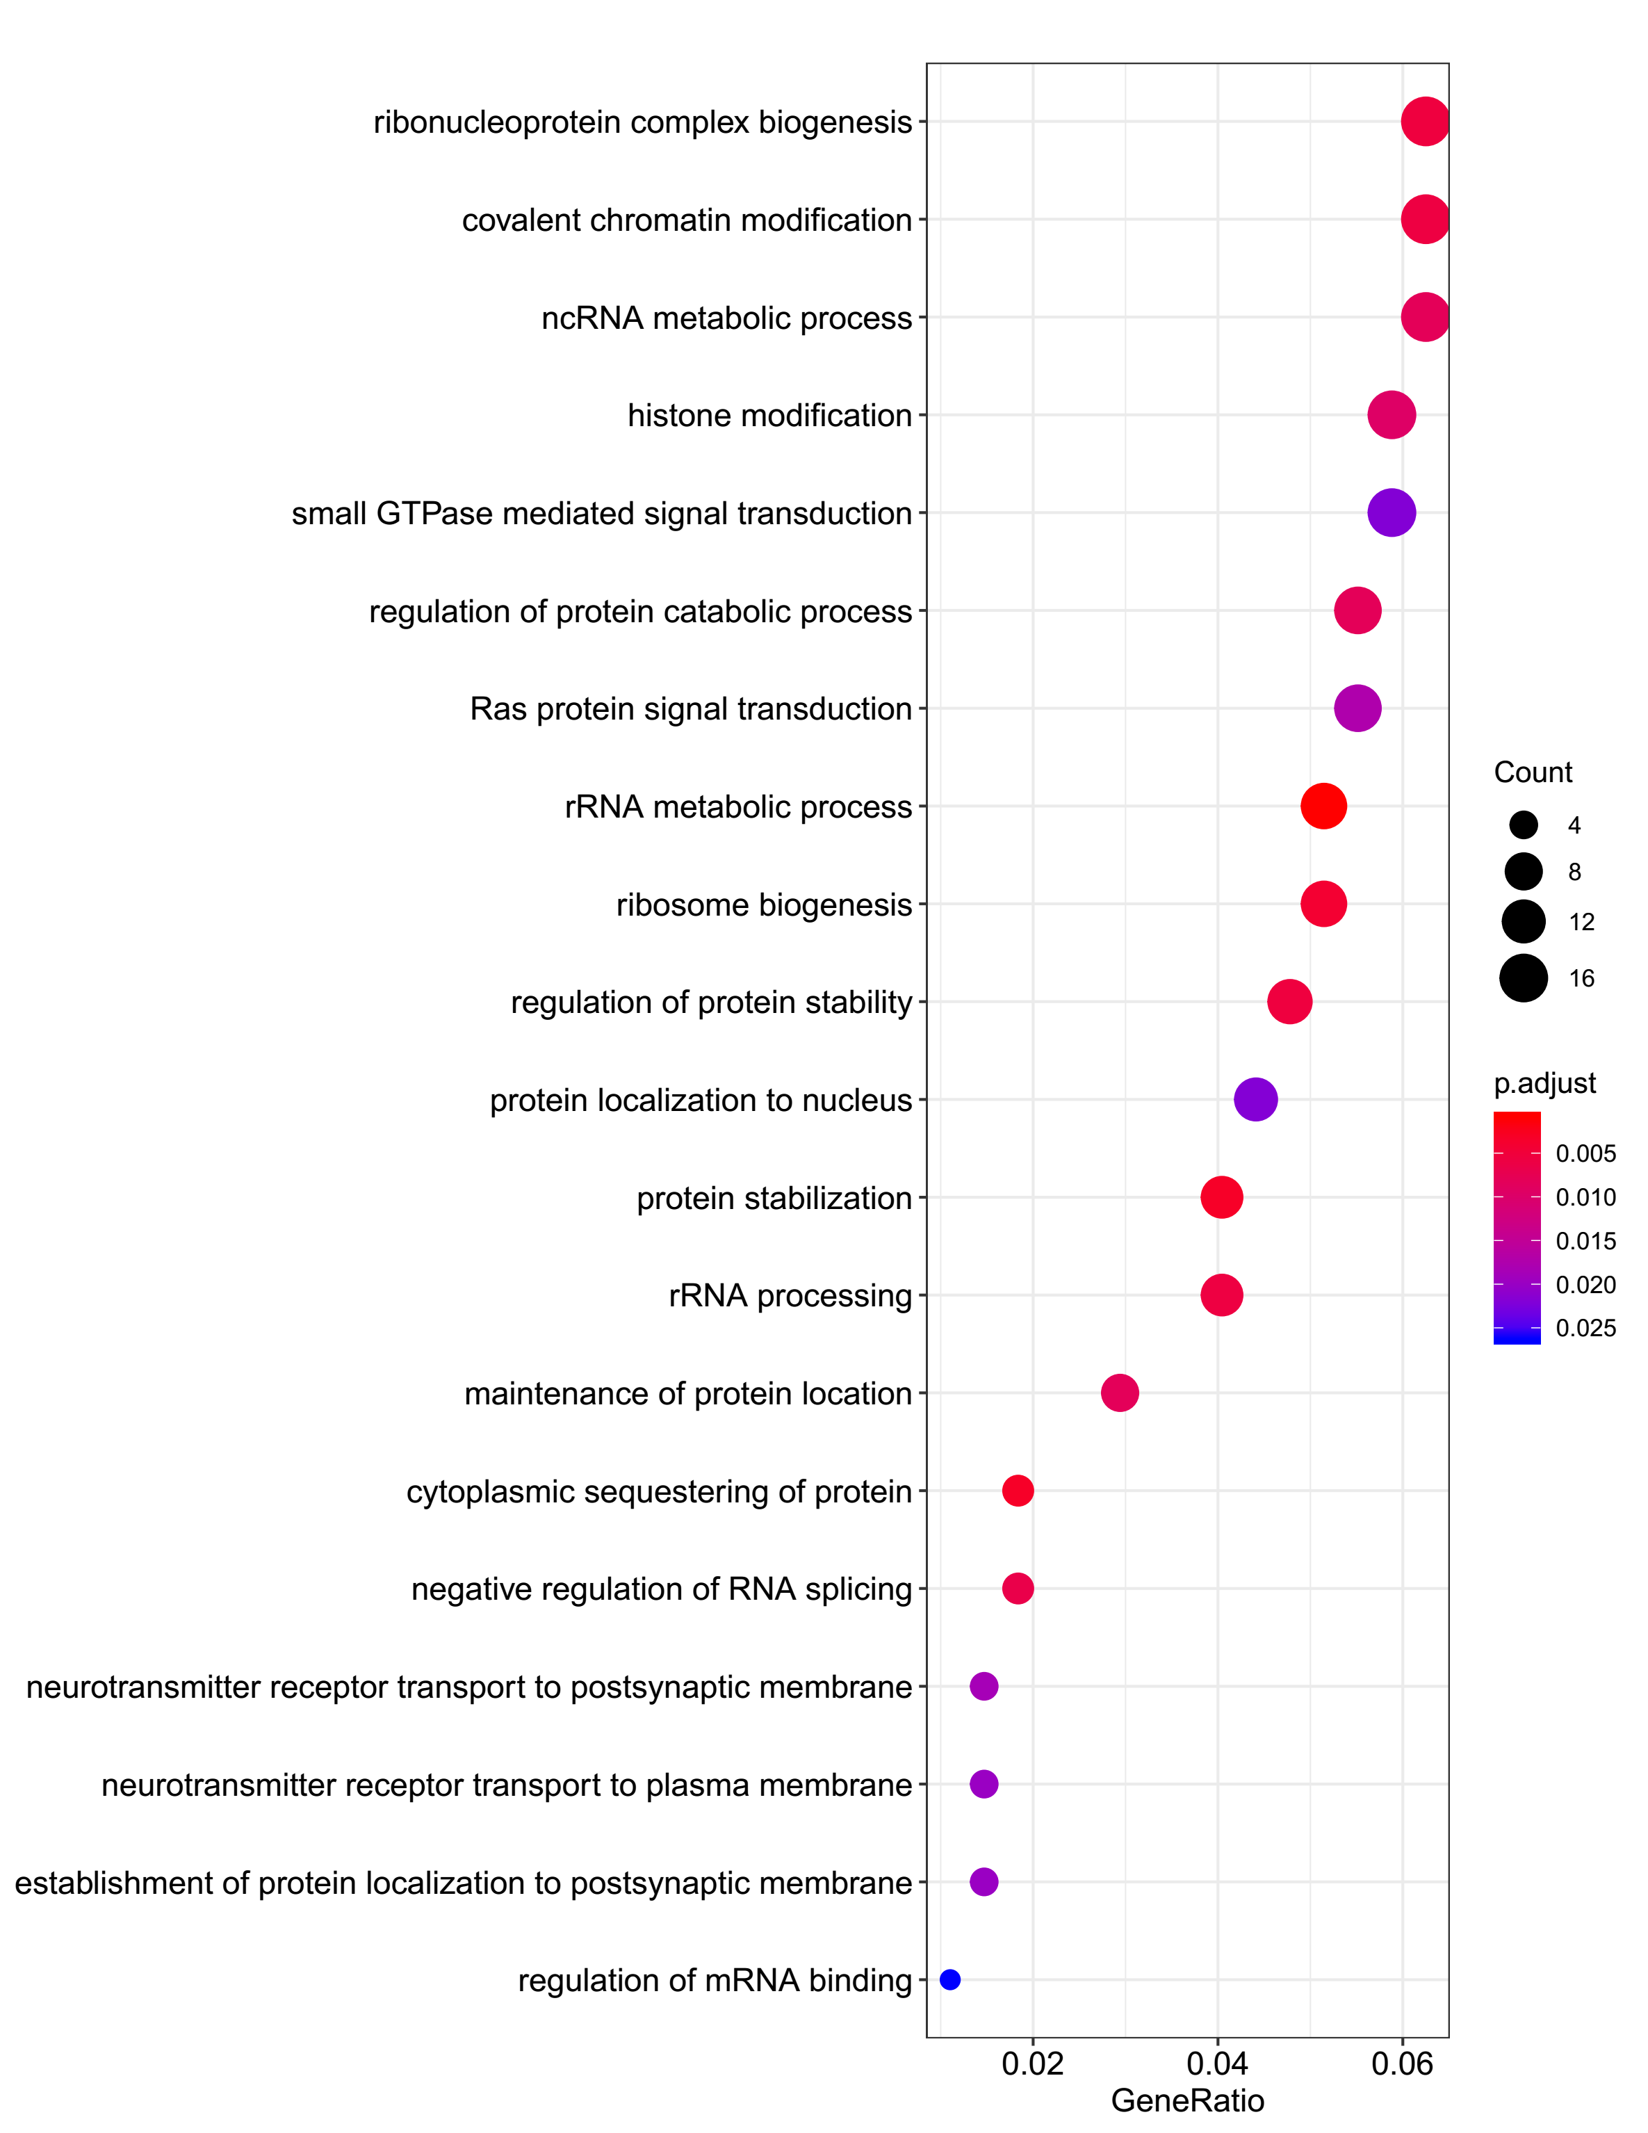
Supplementary Figure 3. GO analysis of the host genes of sisRNAs
3D Mouse 3T3

Slide 7
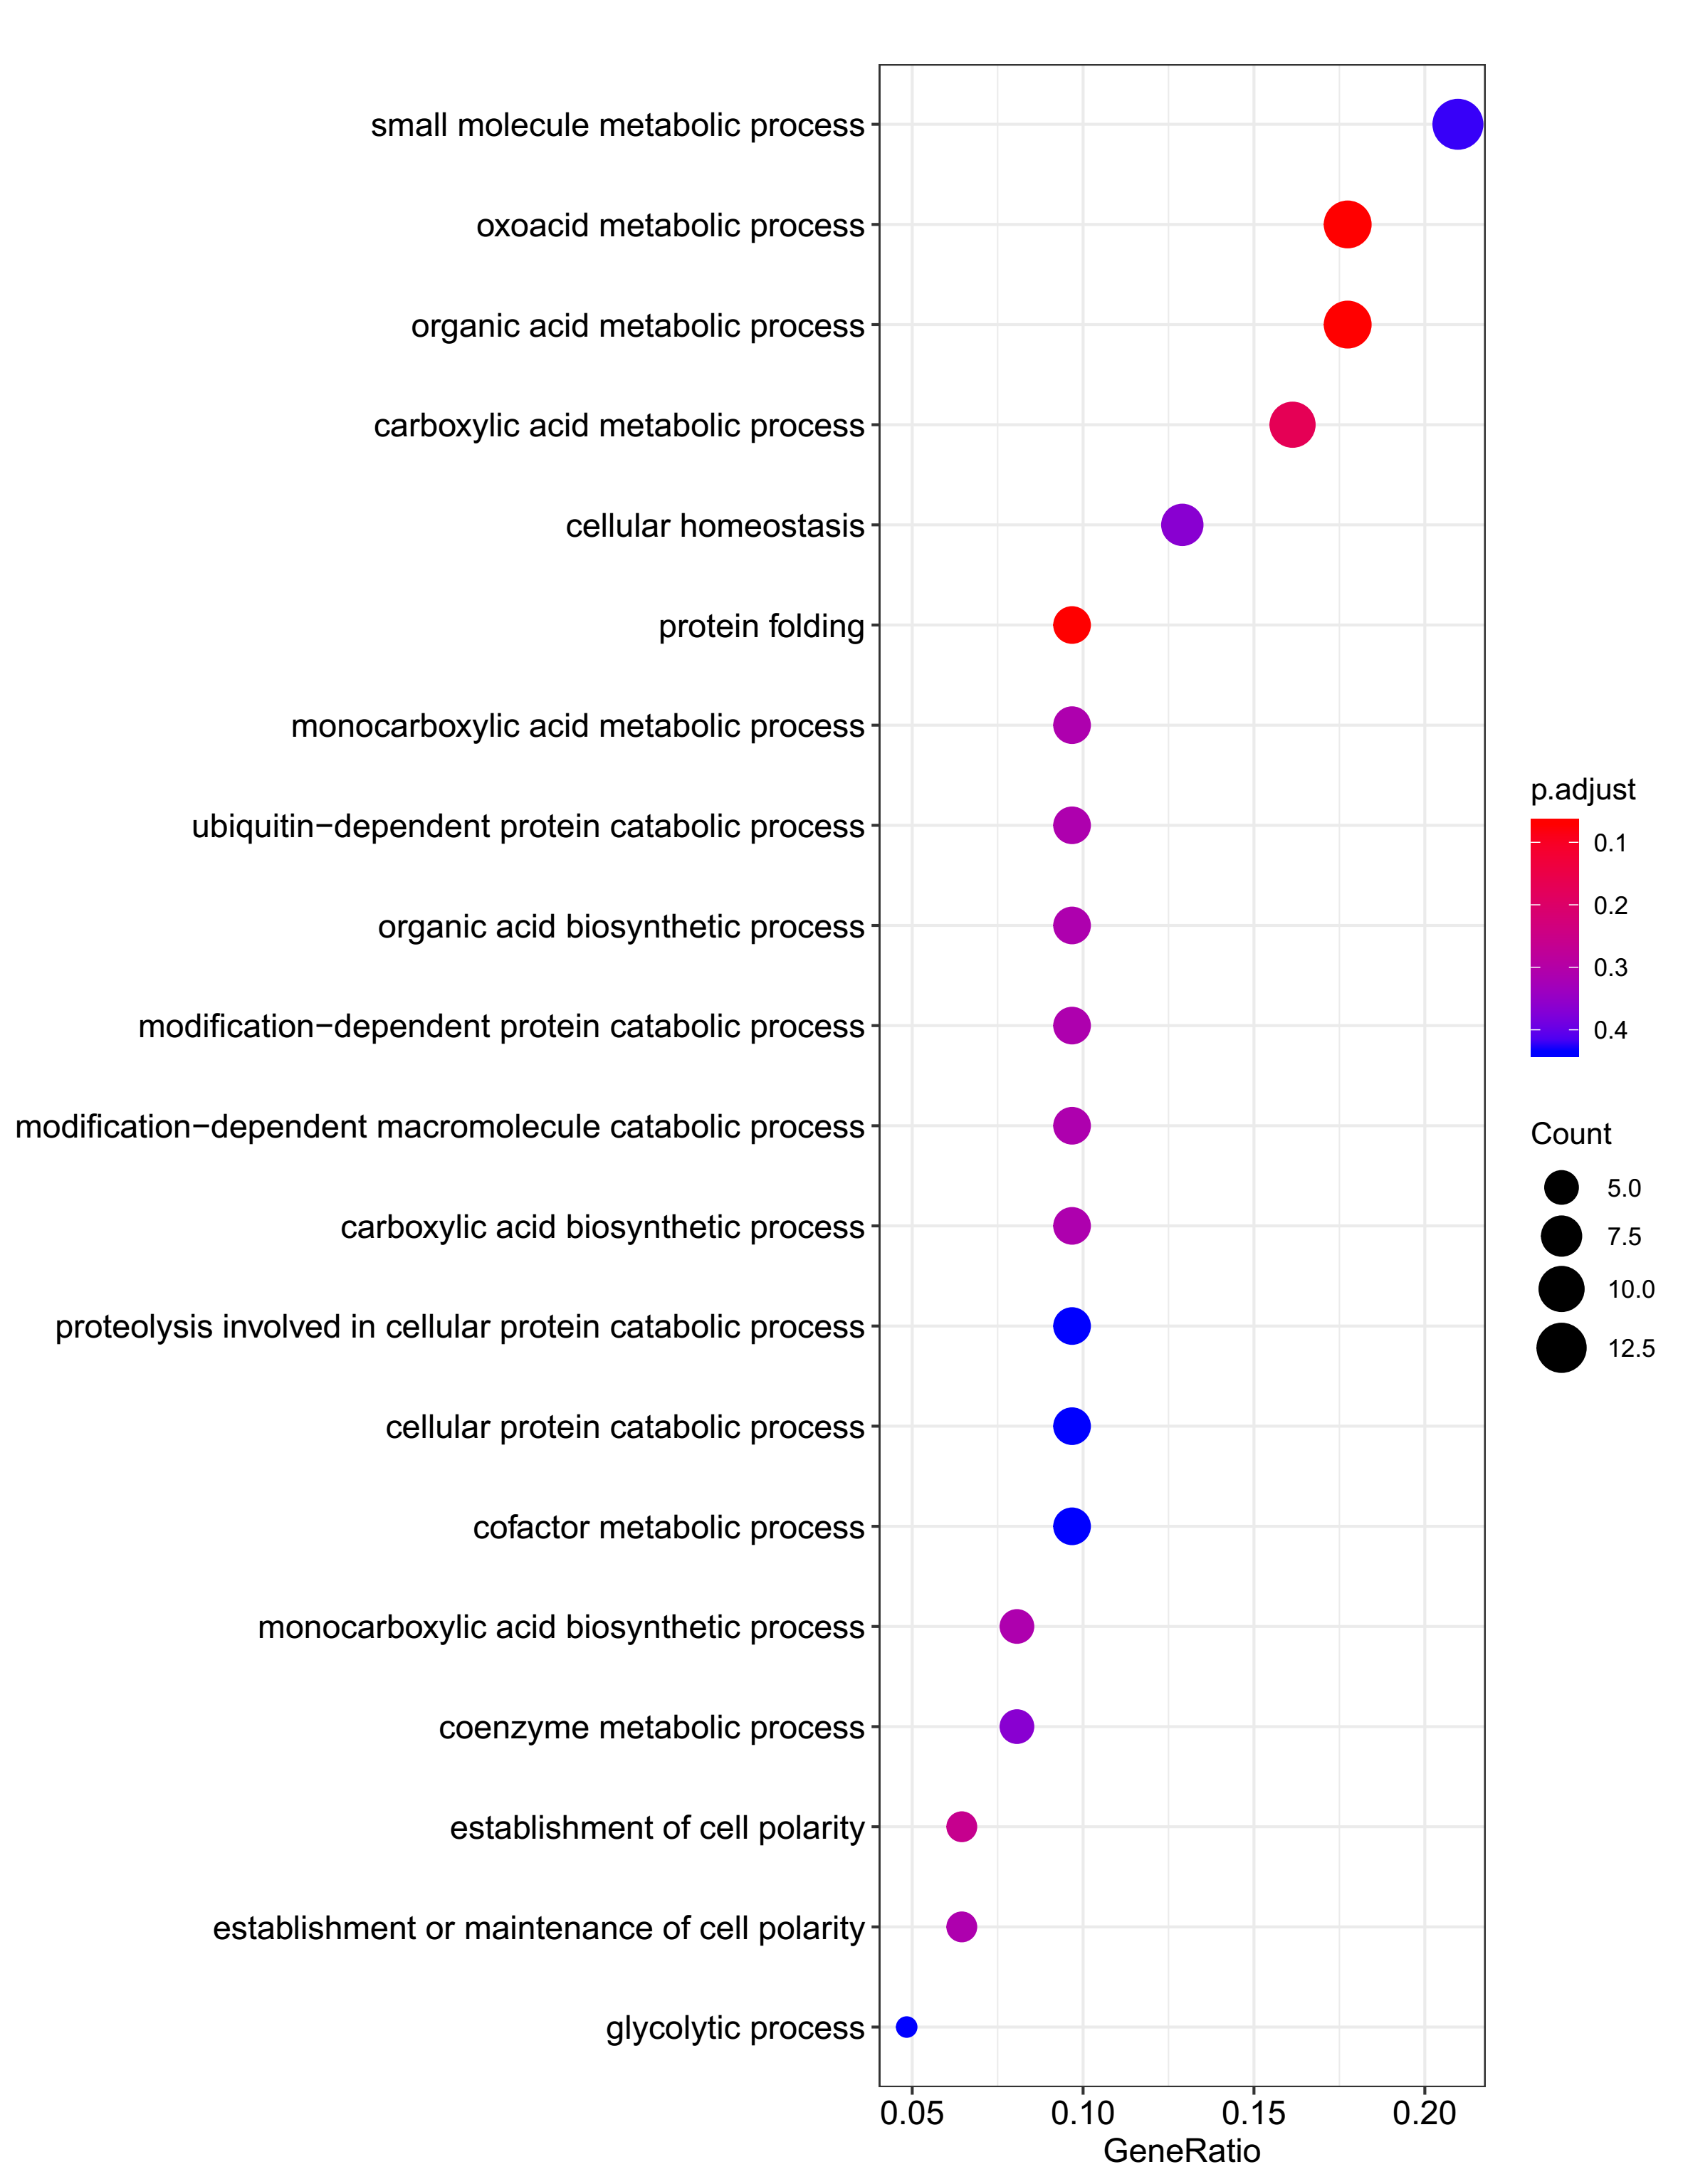
Supplementary Figure 3. GO analysis of the host genes of sisRNAs
3E Chick DF1

Slide 8
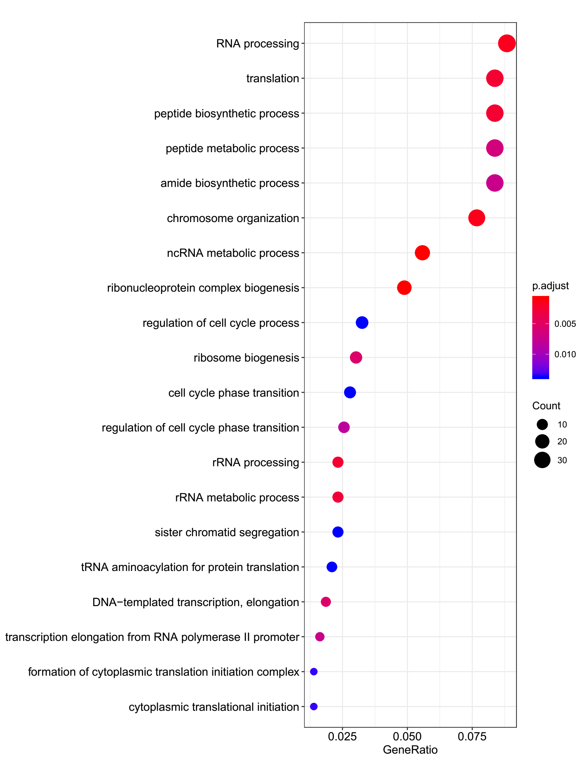
Supplementary Figure 3. GO analysis of the host genes of sisRNAs
3F Xenopus laevis XTC

